Slide 1

Final Project: School Enrollment System
Mariano Nieto
The University of Arizona Global Campus
CST499: Capstone for Computer Software Technology
Professor: Amr Elchouemi
October 31, 2022
Notes:
Welcome. My name is Mariano Nieto, and I will be presenting my school enrollment system that I built for my final capstone project as part of the bachelors of science in the computer software technology program for the university of Arizona global campus.

Slide 2
Introduction
The objective of the student enrollment project
The elements of the SRS (software requirements)
UML design models
Design of the web pages
Design of the relational database
PHP source code
Notes:
In this presentation I am going to discuss the following,

Slide 3

Student Enrollment project
Building the website and making ties to the MySQL database
The website pages:
Landing page
Registration
Login
Profile
View class schedule
Add a class to the schedule
Drop a class
SRS Requirements Document
Notes:
The SRS covers the functional requirements and non-functional requirements for the student enrollment project.
XAMP

Slide 4
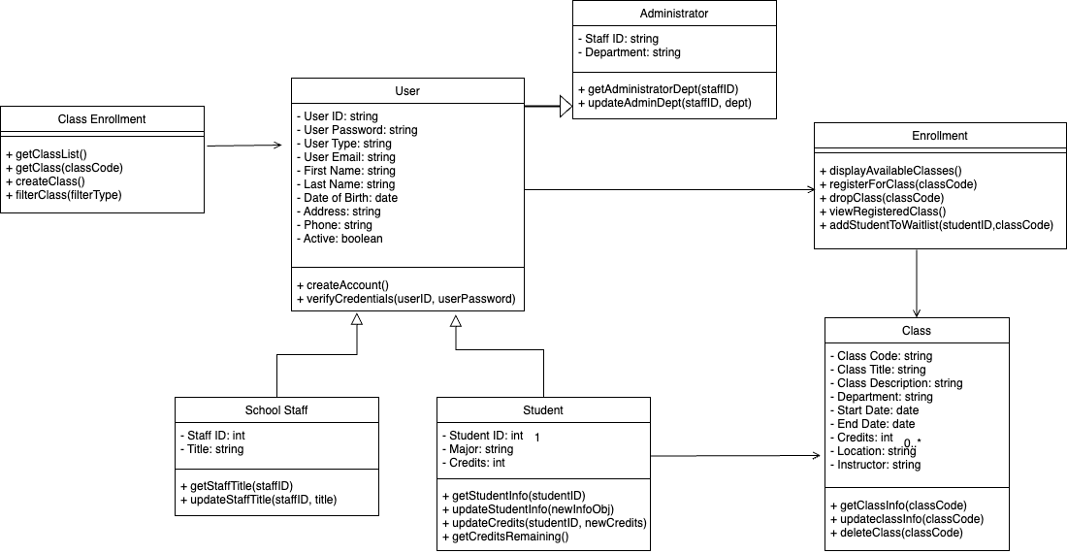
UML Models
Class diagram
Sequence diagram
Activity diagram
Use case diagram
Notes:
The UML diagrams that got used for this project are the class diagram, sequence diagram, activity diagram, and the use case diagram. To the right we have the class diagrams that shows the relationships between the different classes, such as the class enrollment, user, staff, student, class, enrollment, and the administrator.

Slide 5
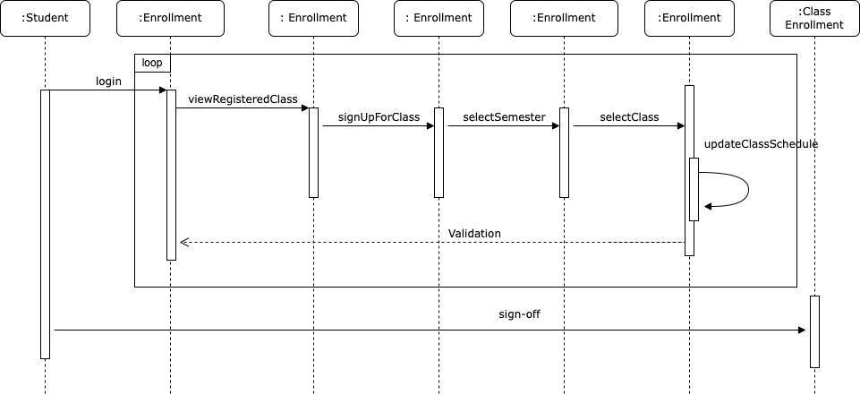
UML Models
Class diagram
Sequence diagram
Activity diagram
Use case diagram
Notes:
In the sequence diagram it shows the sequence of activities and how the classes relate with one another. It shows a student’s flow through the process of the student enrollment system.

Slide 6
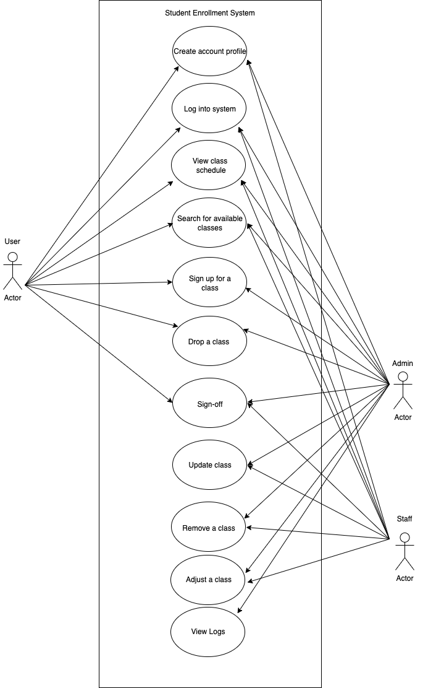
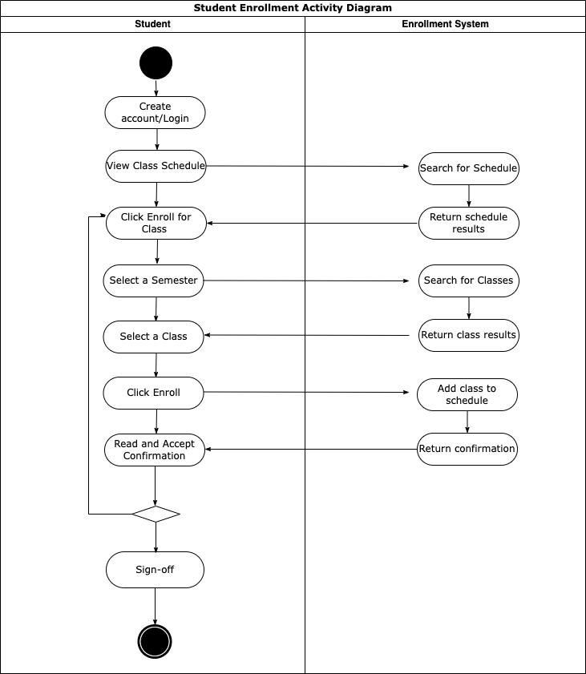
UML Models
Class diagram
Sequence diagram
Activity diagram
Use case diagram
Notes:
The activity diagram is on the left and to the right is the use case diagram. Activity diagram shows the user activity for a student registering for a class. The use case in the diagram displays, creating an account, logging in, view class schedule, register for a class, dropping a class, and logging out.

Slide 7
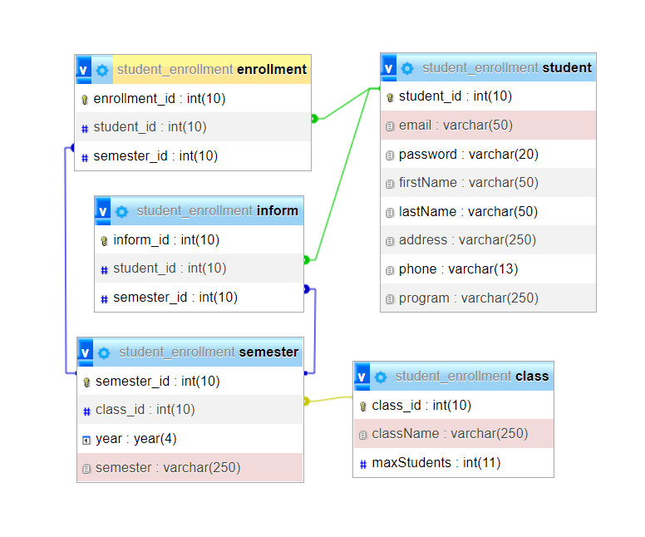
Database Design
Scrum Master
MySQL Database
Five tables
Class
Enrollment
Inform
Semester
Student
Notes:
For the project, I used a relational database called MySQL. For the system, I built five tables, class, enrollment, inform, semester, and student. In the diagram it shows the connections of each table, and how they interact with each other.

Slide 8
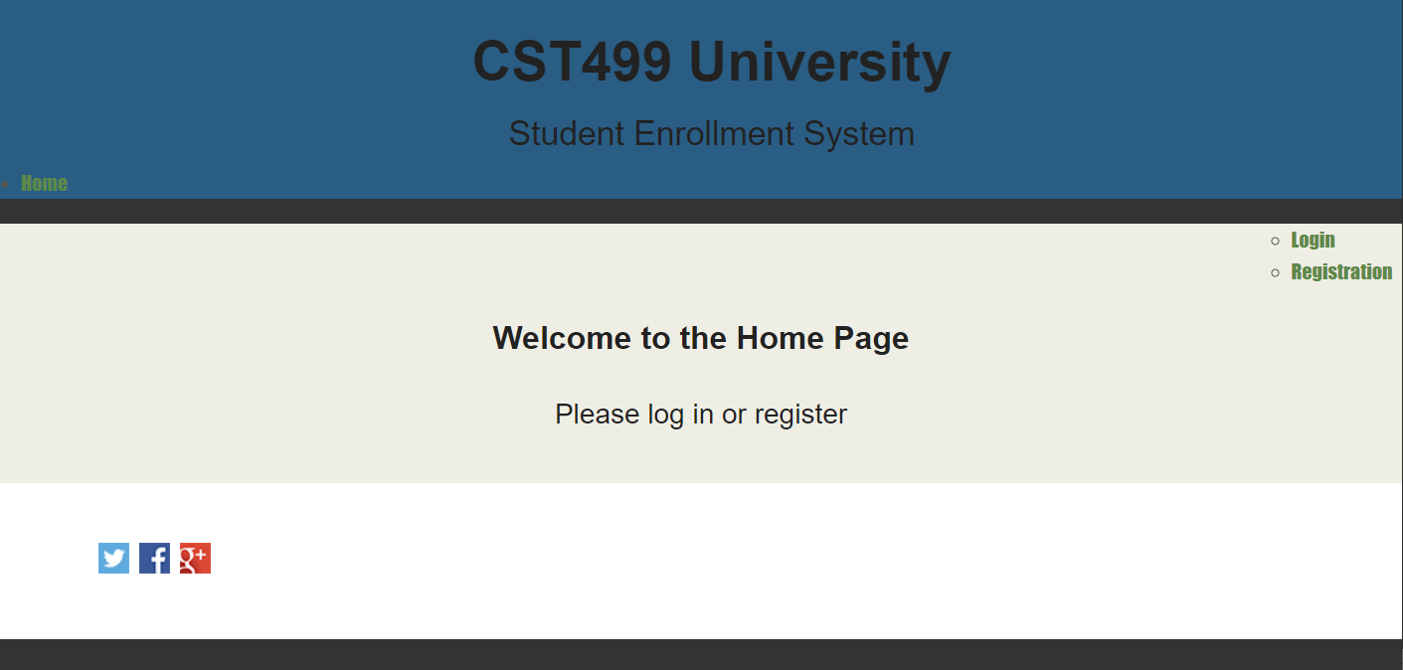
Landing Page
Notes:
Next, I want to present the student enrollment web pages.

Slide 9
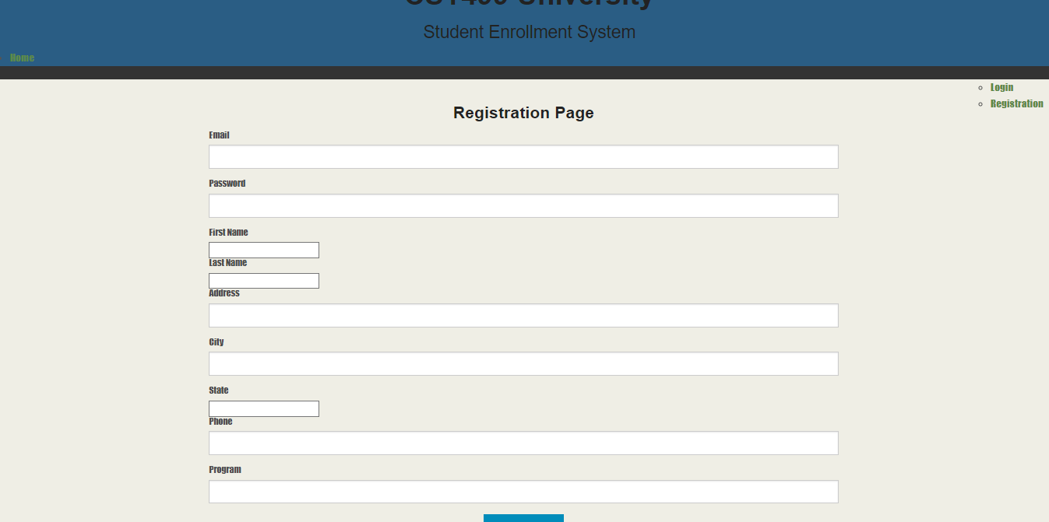
Registration Page

Slide 10
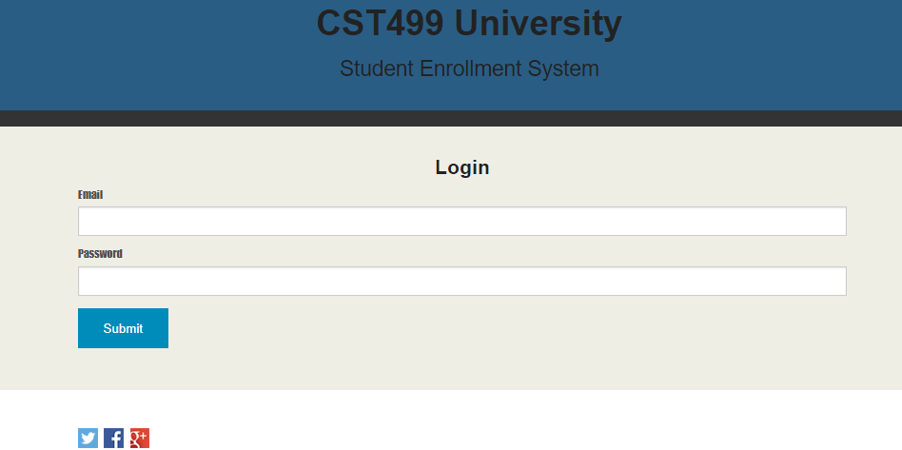
Log in Page
Notes:
Next in line is the log in page.

Slide 11
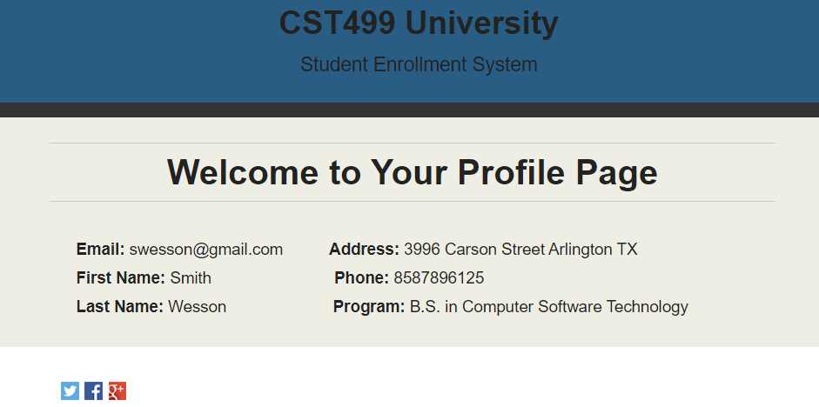
Profile Page

Slide 12
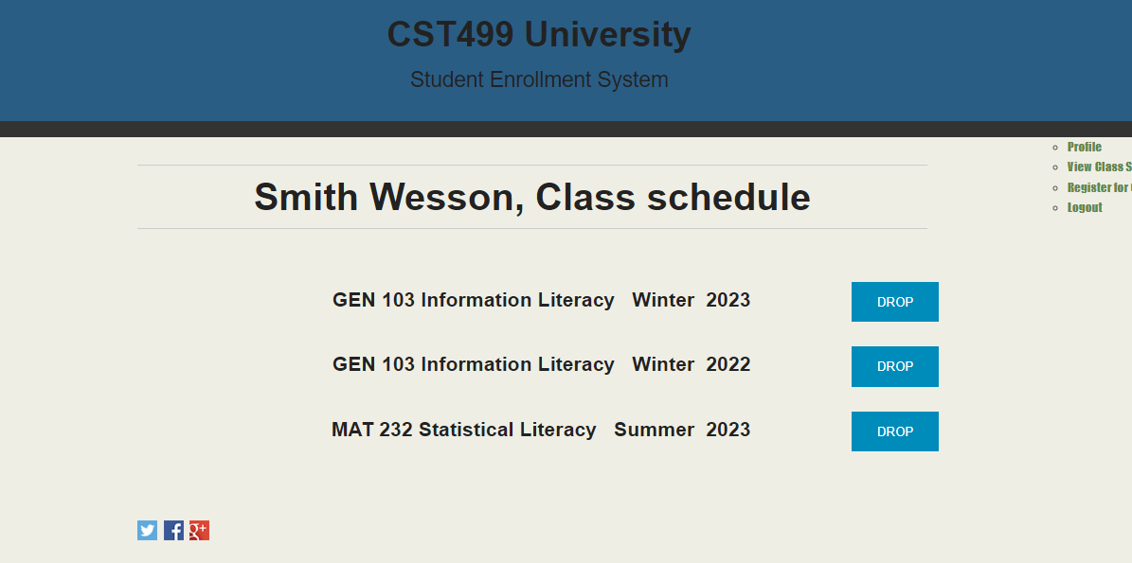
Class schedule Page

Slide 13
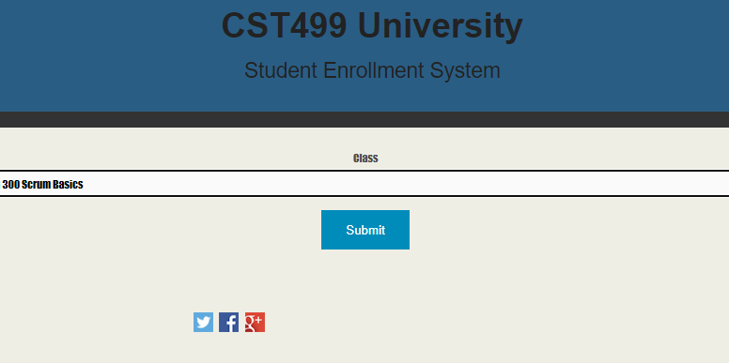
Class enrollment Page

Slide 14
Class schedule Page

Slide 15
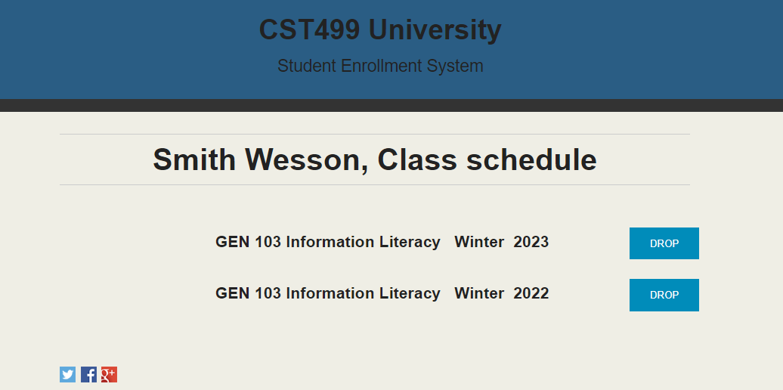
Drop a class Page

Slide 16
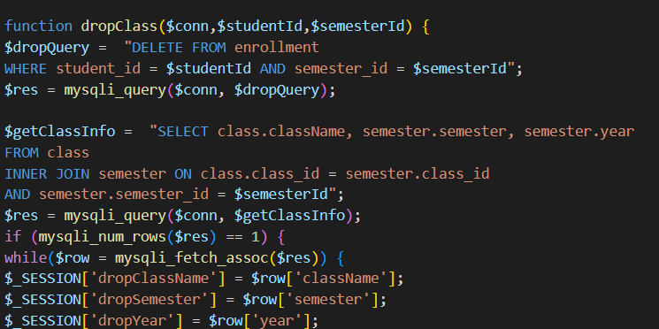
PHP code
Notes:
In this PHP code snippet one can see how I used the function to drop a class.

Slide 17
Thank You!
Notes:
Finally, I want to thank you for allowing me to present my student enrollment system. Thank you!

